Slide 1
205 Oct 21, Class 11
Planning Experiment 2
Chapter 10
  2x2 results, main effects and interactions

Slide 2
Experiment 2
Feedback & Suggestions?
Hypotheses/Predictions
What might be the main effect of Meaning?
What might be the main effect of Encoding?
What interactions might we see?

Slide 3
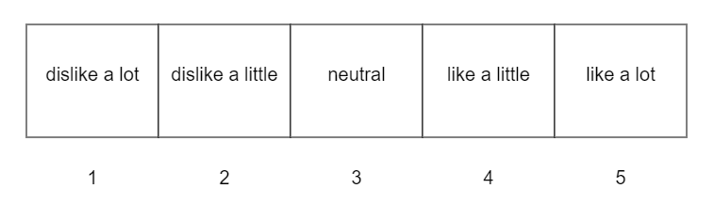
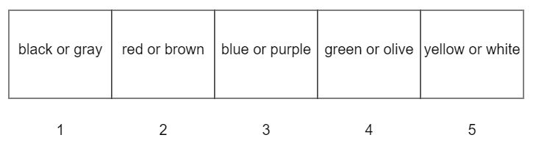
Rating scales
Deep encoding
Liking rating
Shallow encoding
Most prominent color

Slide 4

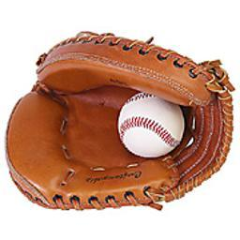
Experiment 2 Design
 |  | Meaningful
 |  | Abstract | Object
Encoding | Shallow | Color? | Color?
 | Deep | Liking? | Liking?

Slide 5
Patterns of Results in 2x2 Designs
Simulated data
Factor 1 has two levels
  Condition A, Condition B
Factor 2 has two levels
  Condition X, Condition Y
Dependent variable is a measure on a 10-point scale
20 participants per condition

Slide 6
Data in a Means Table
Means Table |  | Factor 1
 |  | A | B | Mean
Factor 2 | X | 3.93 (1.43) | 4.21 (1.22) | 4.07 (1.33)
 | Y | 6.98 (1.28) | 6.88 (1.37) | 6.93 (1.33)
 | Mean | 5.45 (2.04) | 5.55 (1.86)

Slide 7
Data terms
Condition or cell means
  Performance of the participants in specific conditions
  AX, AY, BX, BY
Marginal means
  Average performance of participants by factor
  Factor 1: A vs B
    Average(AX,AY) and Average (BX,BY)
  Factor 2: X vs Y
    Average(AX,BX) and Average (AY,BY)
Effect size
  Difference in the marginal means across the factor
  “Unstandardized” = actual DV difference

Slide 8
Data Visualization: Lines and Bars

Slide 9
Data 2
Means Table |  | Factor 1
 |  | A | B | Mean
Factor 2 | X | 3.27 (1.51) | 7.09 (1.35) | 5.18 (2.39)
 | Y | 3.65 (1.08) | 7.44 (1.44) | 5.55 (2.28)
 | Mean | 3.46 (1.33) | 7.26 (1.41)

Slide 10
Data 2

Slide 11
Data 3
Means Table |  | Factor 1
 |  | A | B | Mean
Factor 2 | X | 2.36 (1.54) | 4.70 (1.54) | 3.53 (1.93)
 | Y | 4.00 (1.08) | 6.38 (1.44) | 5.19 (1.84)
 | Mean | 3.18 (1.63) | 5.54 (1.74)

Slide 12
Data 3

Slide 13
Data 4
Means Table |  | Factor 1
 |  | A | B | Mean
Factor 2 | X | 1.43 (1.32) | 4.43 (2.00) | 2.93 (2.26)
 | Y | 3.56 (1.39) | 9.31 (1.38) | 6.43 (3.19)
 | Mean | 2.50 (1.72) | 6.87 (2.98)

Slide 14
Data 4

Slide 15
Data 5
Means Table |  | Factor 1
 |  | A | B | Mean
Factor 2 | X | 6.70 (1.76) | 4.34 (1.58) | 5.52 (2.04)
 | Y | 3.92 (1.42) | 4.51 (1.29) | 4.21 (1.39)
 | Mean | 5.31 (2.11) | 4.43 (1.45)

Slide 16
Data 5

Slide 17
Data 6
Means Table |  | Factor 1
 |  | A | B | Mean
Factor 2 | X | 3.29 (1.07) | 5.87 (1.54) | 4.58 (1.85)
 | Y | 6.59 (1.63) | 3.20 (1.31) | 4.90 (2.25)
 | Mean | 4.94 (2.15) | 4.53 (1.96)

Slide 18
Data 6

Slide 19
2x2 Data
Main effects
  Factor 1: effect on performance ignoring Factor 2
  Factor 2: effect on performance ignoring Factor 1
  Possible outcomes: both, either one alone, or neither
Interactions
  The factors affect each other
  The effect of Factor 1 was different across levels of Factor 2
  The effect of Factor 2 was different across levels of Factor 1
  “Different”
    Accelerator: super-additive factors
    Reducer: can give a 3:1 shape
    Inverter: effect goes in different directions

Slide 20
Types of 2x2 designs
Two manipulated factors, between participants
  Experimenter assigns participants to one of the four conditions
One manipulated factor, one participant variable
  Measure or recruit based on participant variable
    Split into 2 groups by median or pre-defined criterion
  Random assignment across manipulated factor
Two within-participant factors
  Participants each do all four conditions, counterbalanced order
One within-participant factor, Repeated Measures
  Participants randomly assigned to AX,AY or BX,BY
    Order counterbalanced
  Mixed-model design

Slide 21
Order effects in within-participants design
In a simple 2 group within-participants study, participants complete both conditions of the experiment, order counterbalanced
  A versus B
If order substantially affects the DV, the design has accidentally become a mixed-model 2x2
  Factor 1: A, B
  Factor 2: Order 1 (X), Order 2 (Y)
Observing an interaction complicates the inference

Slide 22
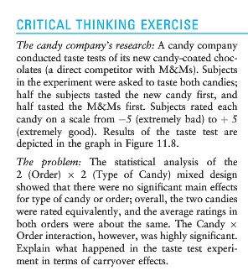
Taste test

Slide 23
For Wed Oct 23
Chapter 11: External Validity, Sampling
  Short introduction to the general idea
Assefi & Garry (2003). More 2x2 design practice.
Collect data for Experiment 2
  Try to get 4 people to volunteer to try the study
    Submit completion codes if they provide them
  Deadline: Friday night
    Assignment extended through weekend if needed

